Slide 1
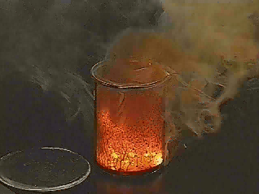
III. Reaction Energy
(p. 514 - 517)
Chemical Reactions
C. Johannesson

Slide 2
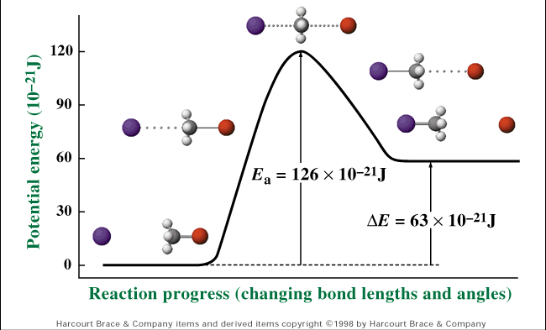
A. Reaction Pathway
Shows the change in energy during a chemical reaction
C. Johannesson

Slide 3
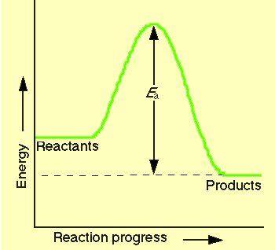
B. Exothermic Reaction
reaction that
releases
energy
products have
lower PE
than reactants
energy
released
2H₂(l) + O₂(l) → 2H₂O(g) + energy
C. Johannesson

Slide 4
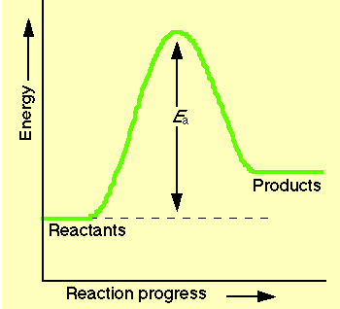
C. Endothermic Reaction
reaction that
absorbs
energy
reactants have
lower PE
than products
energy
absorbed
2Al₂O₃ + energy → 4Al + 3O₂
C. Johannesson

